Slide 1
Probability Default (PD) Prediction:
Forward Intensity Model
Giho Park

Slide 2
Benefit
Risk Management
Credit portfolioi management
Policy setting and regulatory purpose

Slide 3
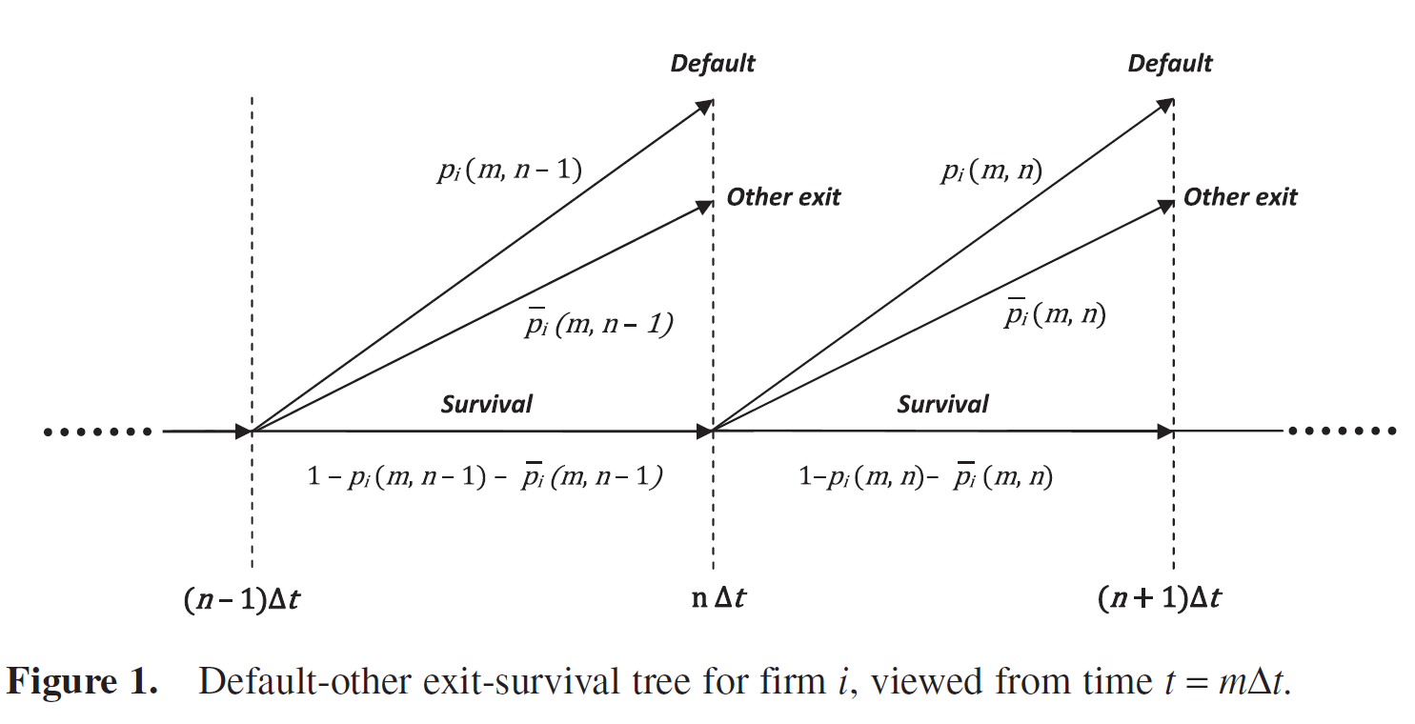
Diagram of three states
: the conditional probability viewed from t=m·dt that firm I will default before (n+1) ·dt,
conditioned on firm I surviving up until n·dt
: non-default probability
: survival probability
Notes:
In the forward intensity model, a firm’s default is signaled by a jump in a Poisson process. The probability of a jump in the Poisson process is determined by the intensity of the Poisson process.
The forward intensity model draws an explicit dependence of intensities at the time periods in the future (that is , forward intensities) on the values of input variables at the time of prediction.
With forward intensities, PDs for any forecast horizon can be computed knowing only the values of the input variables at the time of prediction,
without needing to simulate future values of the input variables.

Slide 4
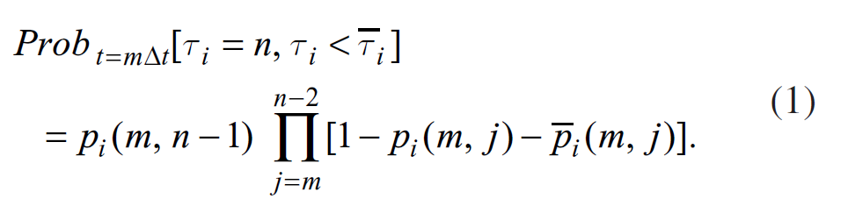
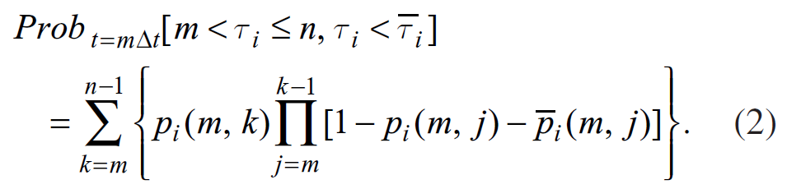
Prob. of default and joint Prob
The probability at time t = mΔt of firm i surviving until (n– 1)Δt and then defaulting between (n – 1)Δt and nΔt is:
At mΔt the probability of firm i defaulting at or before nΔt and not having an
other exit before t = nΔt is obtained by taking the sum of all of the paths that lead to default at or before nΔt:

Slide 5






Default prob. Vs. Forward intensity
The forward intensity for the default of firm i that is observed at time t = mΔt for the forward time interval from t = nΔt to (n + 1)Δt, is denoted by hi(m,n)
The corresponding forward intensity for a non-default exit is denoted by hi(m,n).
β and β¯ are coefficient vectors that are functions of the number of months between the observation date and the beginning of the forward period (n − m), and Yi(m) is simply the vector Xi(m) augmented by a preceding unit element: Yi(m) = (1, Xi(m)).

Slide 6
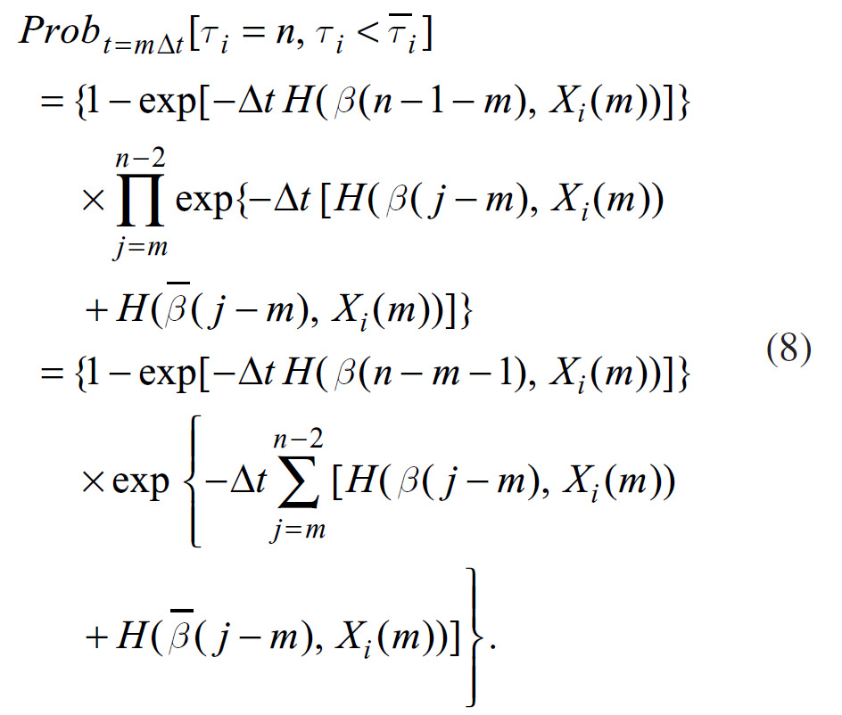
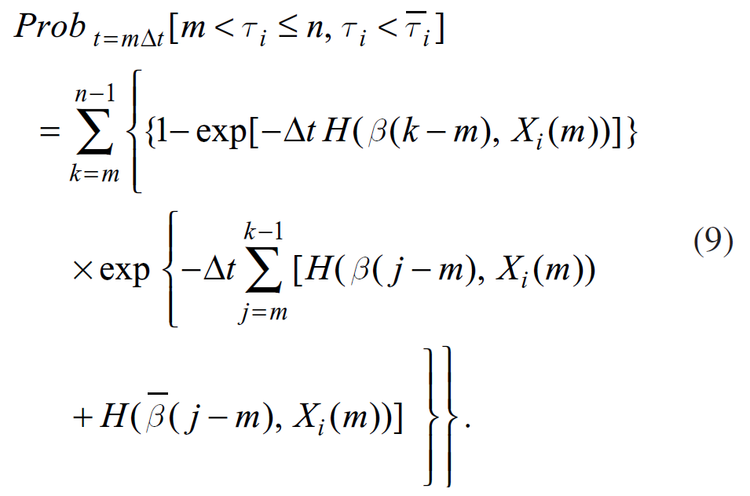
Probabilities w.r.t forward intensity
(1) → (8) and (2) → (9)

Slide 7
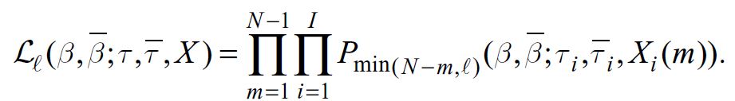

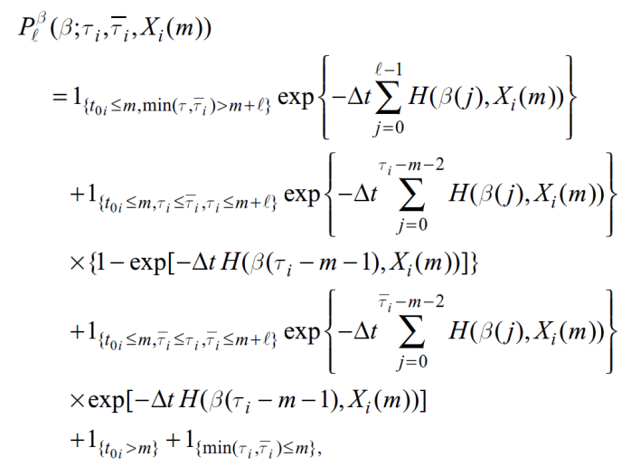
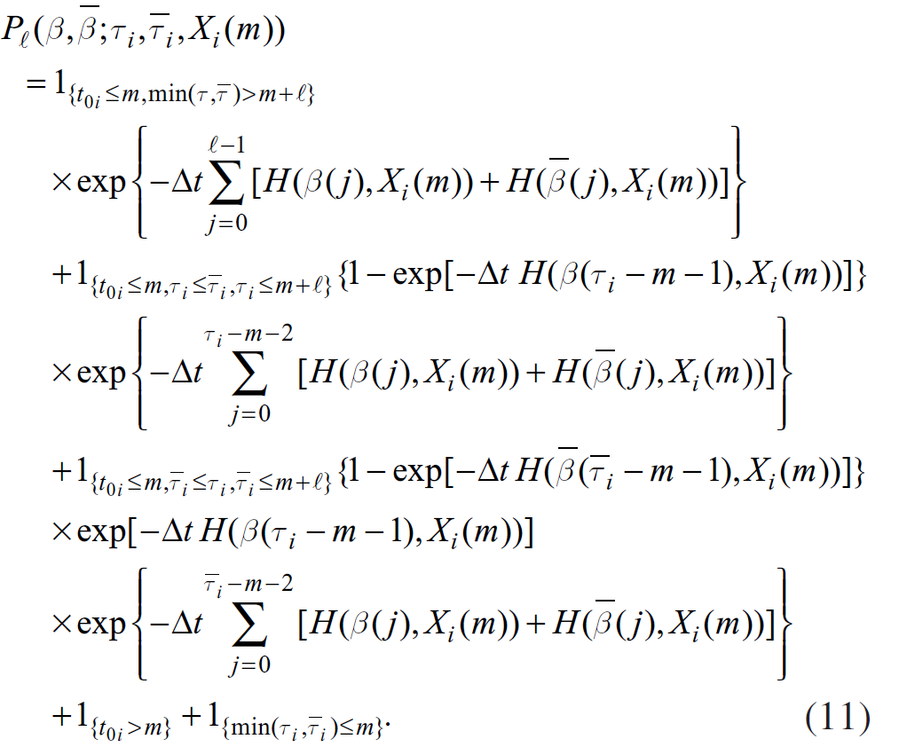
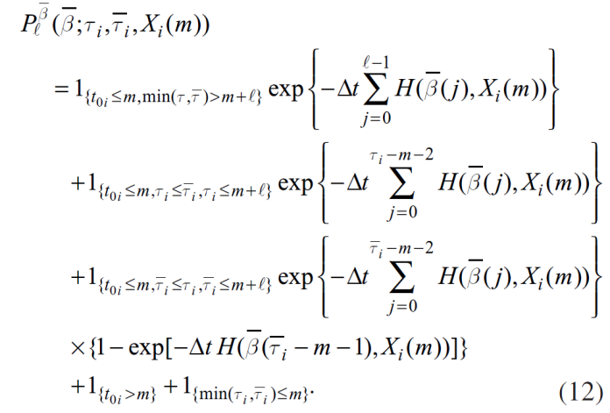
Pseudo-Likelihood Function
The nature of the probability
Depending on what happens to
the firm during the period from
month m to month m + min (N – m, ).

Slide 8

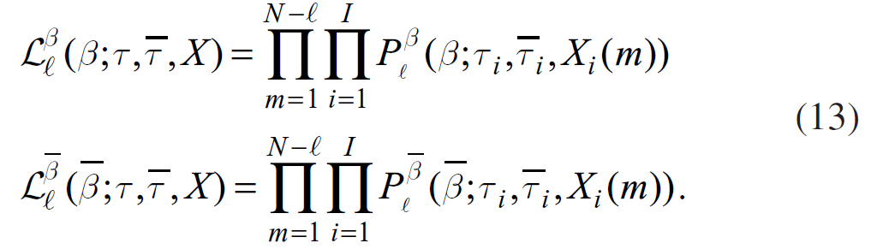
Pseudo-Likelihood Function

Slide 9
References
Duffie, Dl, L. Saita and K. Wang (2007) Multi-Period Corporate Default Prediction with Stochastic Covariates, Journal of Financial Economics, 83, pp. 635-665
Duan, J.-C, J. Sun and T. Wang (2012), Multiperiod Corporate Default Prediction A forward intensity Approach, Journal of Econometrics, 170, pp. 191-209
Duan, J.-C, and A. Fulop (2013), Multiperiod Corporate Default Prediction with the Partially-Conditioned Forward intensity, National University of Singapore Working Paper

